Slide 1
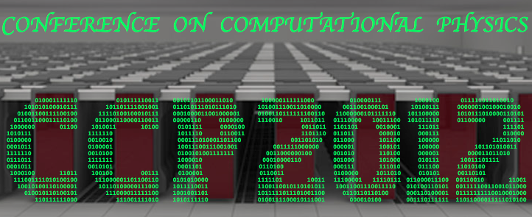
Computational Particle Physics
for
Event simulation and Analysis

Slide 2
From Goals to Means

Slide 3
Overview from goals to means
Particle Physics goals
Computational issues
Physics Process computations
Matrix element for:
  Event generators
  Data Analysis
Cross disciplinary issues

Slide 4
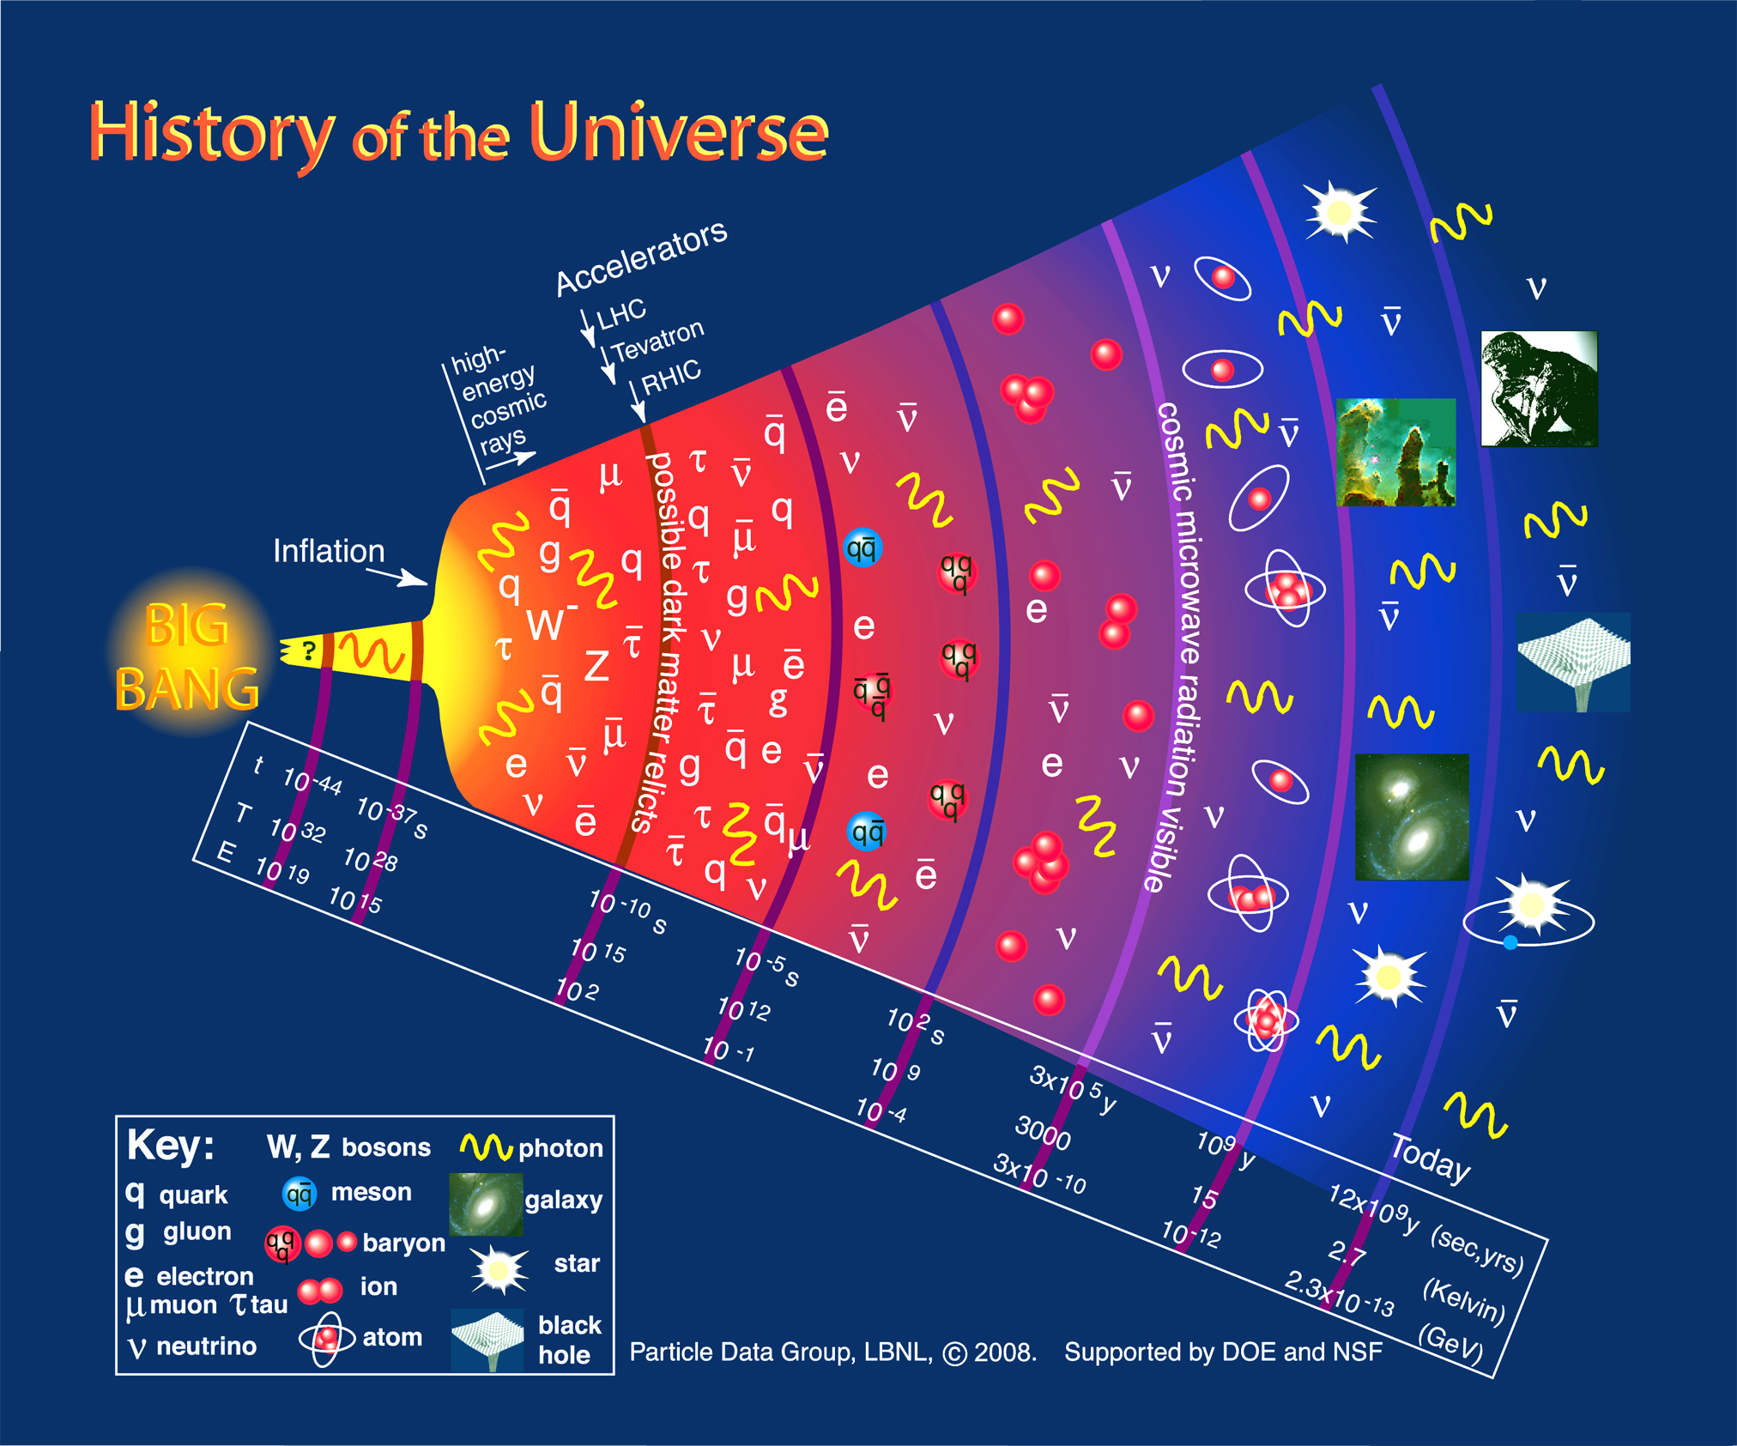

Slide 5
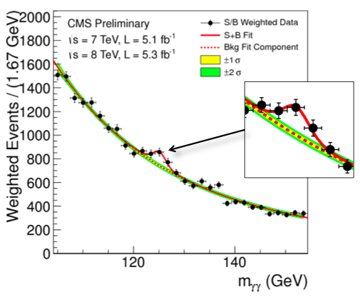
CERN-LHC “New Boson” discovery
PP -> H+X -> γγ +X

Slide 6
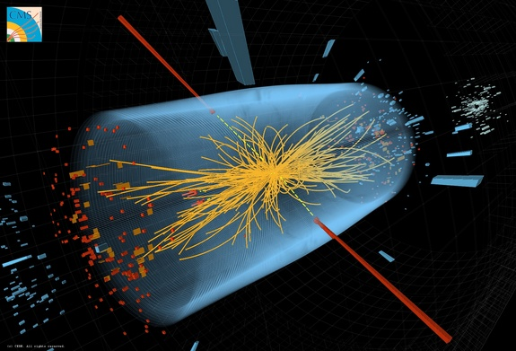
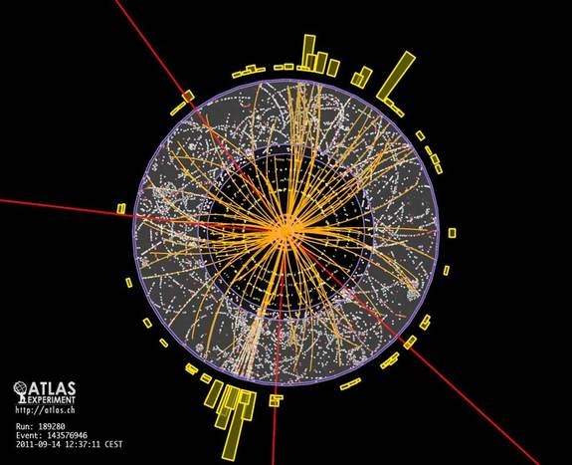
LHC Events
@ 7.5 TeV

Slide 7
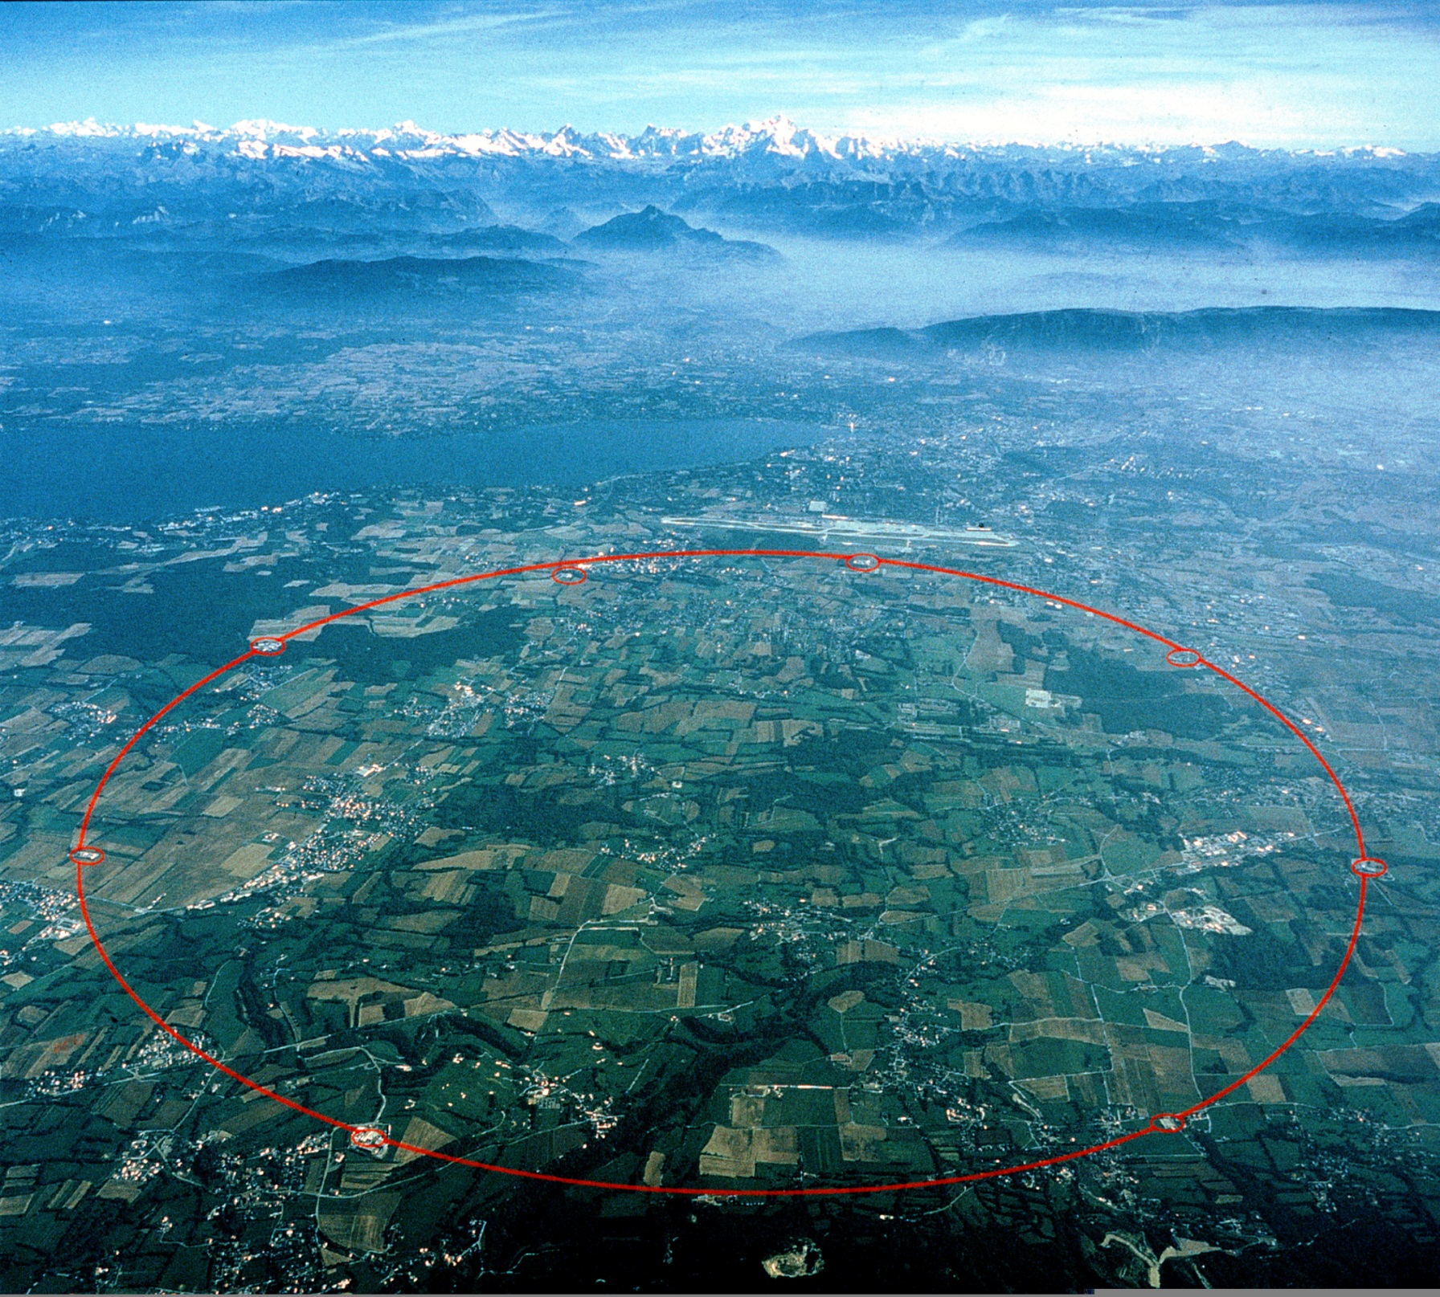
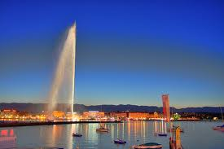
Top of Europe
Mont Blanc
Geneva jet d’eau
Geneva intl. airport
CERN LHC
~100 m underground
27 km long tunnel

Slide 8
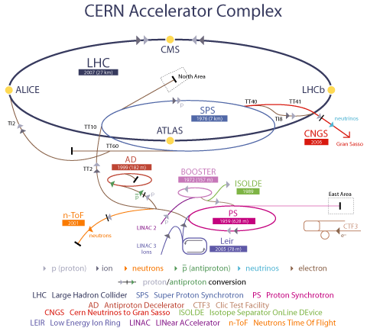

Slide 9
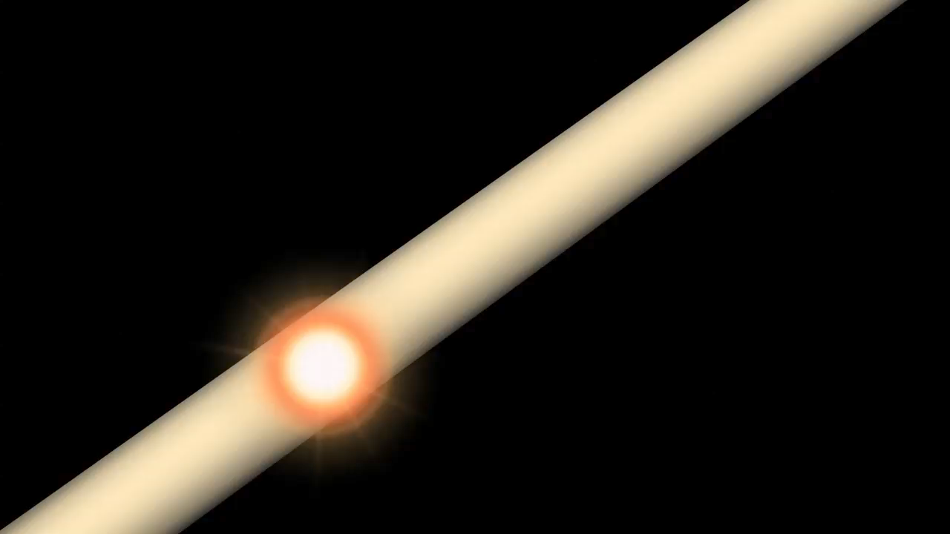
ATLAS Experiment © 2012 CERN

Slide 10
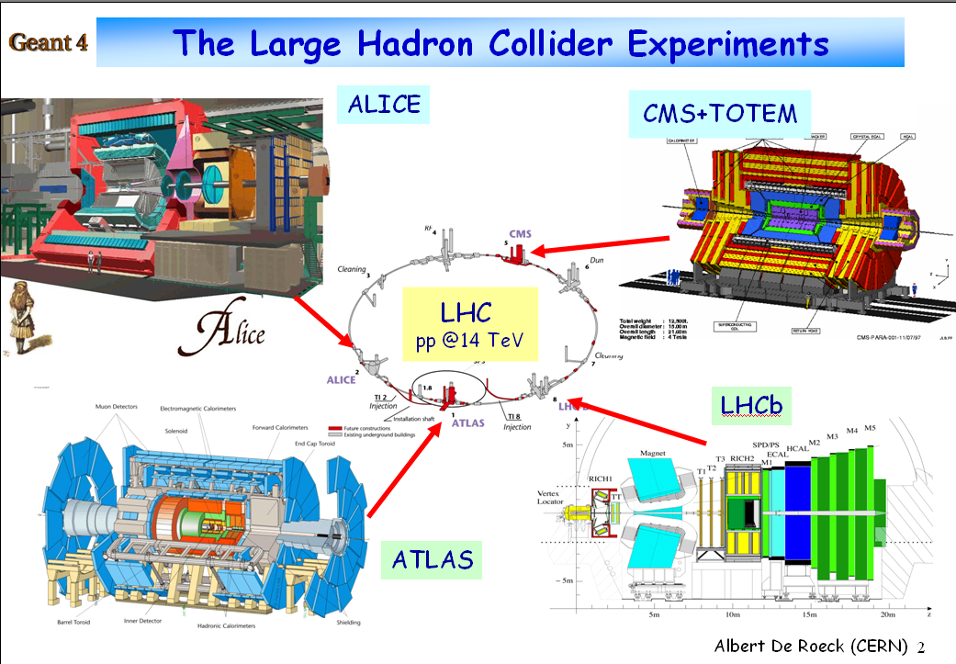

Slide 11
Computing needed at all stages
Accelerator Design, monitoring, operation and optimization
Data acquisition (150 million sensors)
Detector design, acceptance/efficiency,
Event reconstruction
Event selection and classification
Event analysis
Theory interpretation
Build or tested by Monte-Carlo Physics Simulation

Slide 12
Monte-Carlo Event Simulation a major component of
Particle Physics

Slide 13
Simulation and Data Analysis Chain
Physics Model (e.g. SM,SUSY,…)
Nature’s Laws
Process (e.g. PP->H+X->γγ+X)
Event simulation
Event Generator
Event: E/P Quadri-vectors
Detector Simulations (GEANT4)
Experiments
Event: Hits, Energies, Timing
Event: Hits, Energies, Timing
Event Reconstruction
Comparison
Event: E/P Quadri-vectors

Slide 14
Frontier Computation
Complexity
Worldwide collaborations

Slide 15
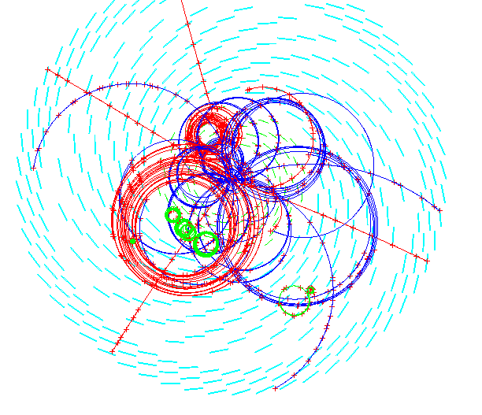
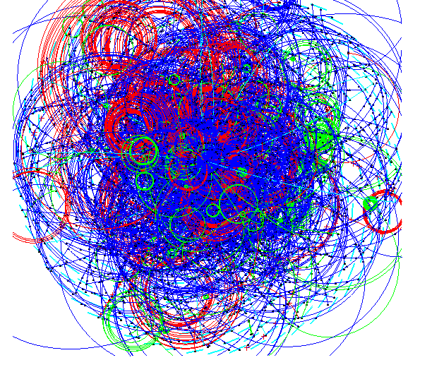
Complexity
Signal event is obscured by
~ 20 overlapping uninteresting collisions in same crossing
One event
One crossing (every 25 ns)

Slide 16
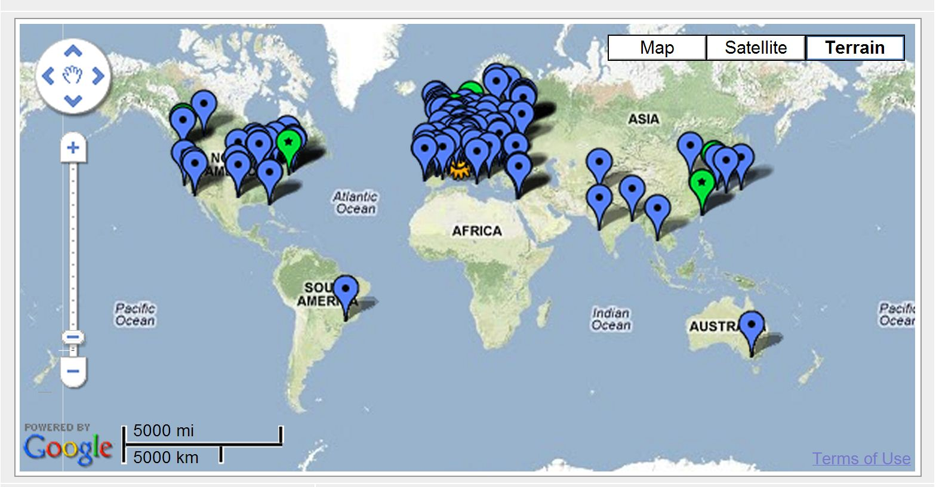
LCG Data Grid
World Wide Collaboration ⇒ distributed computing & storage capacity

Slide 17
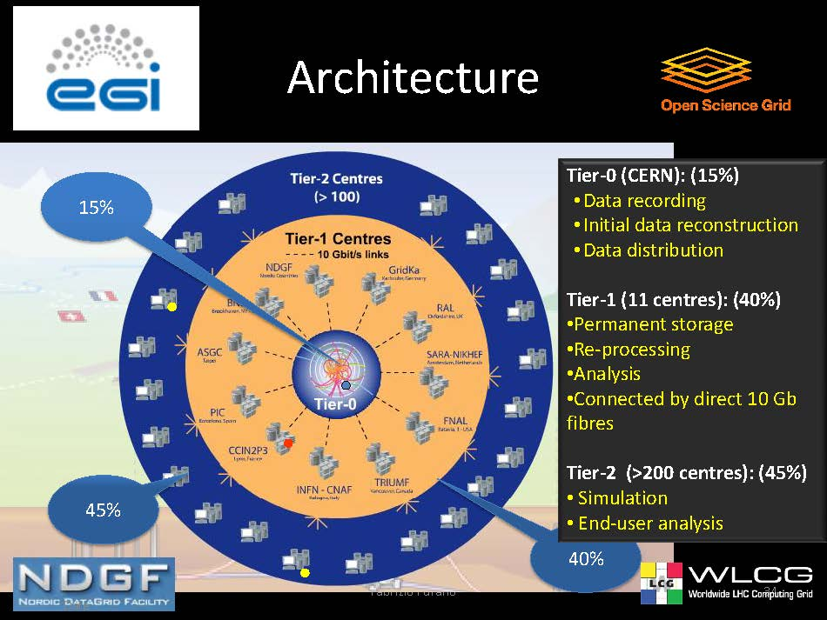
Data Grid
F. Furano, CERN-IT

Slide 18
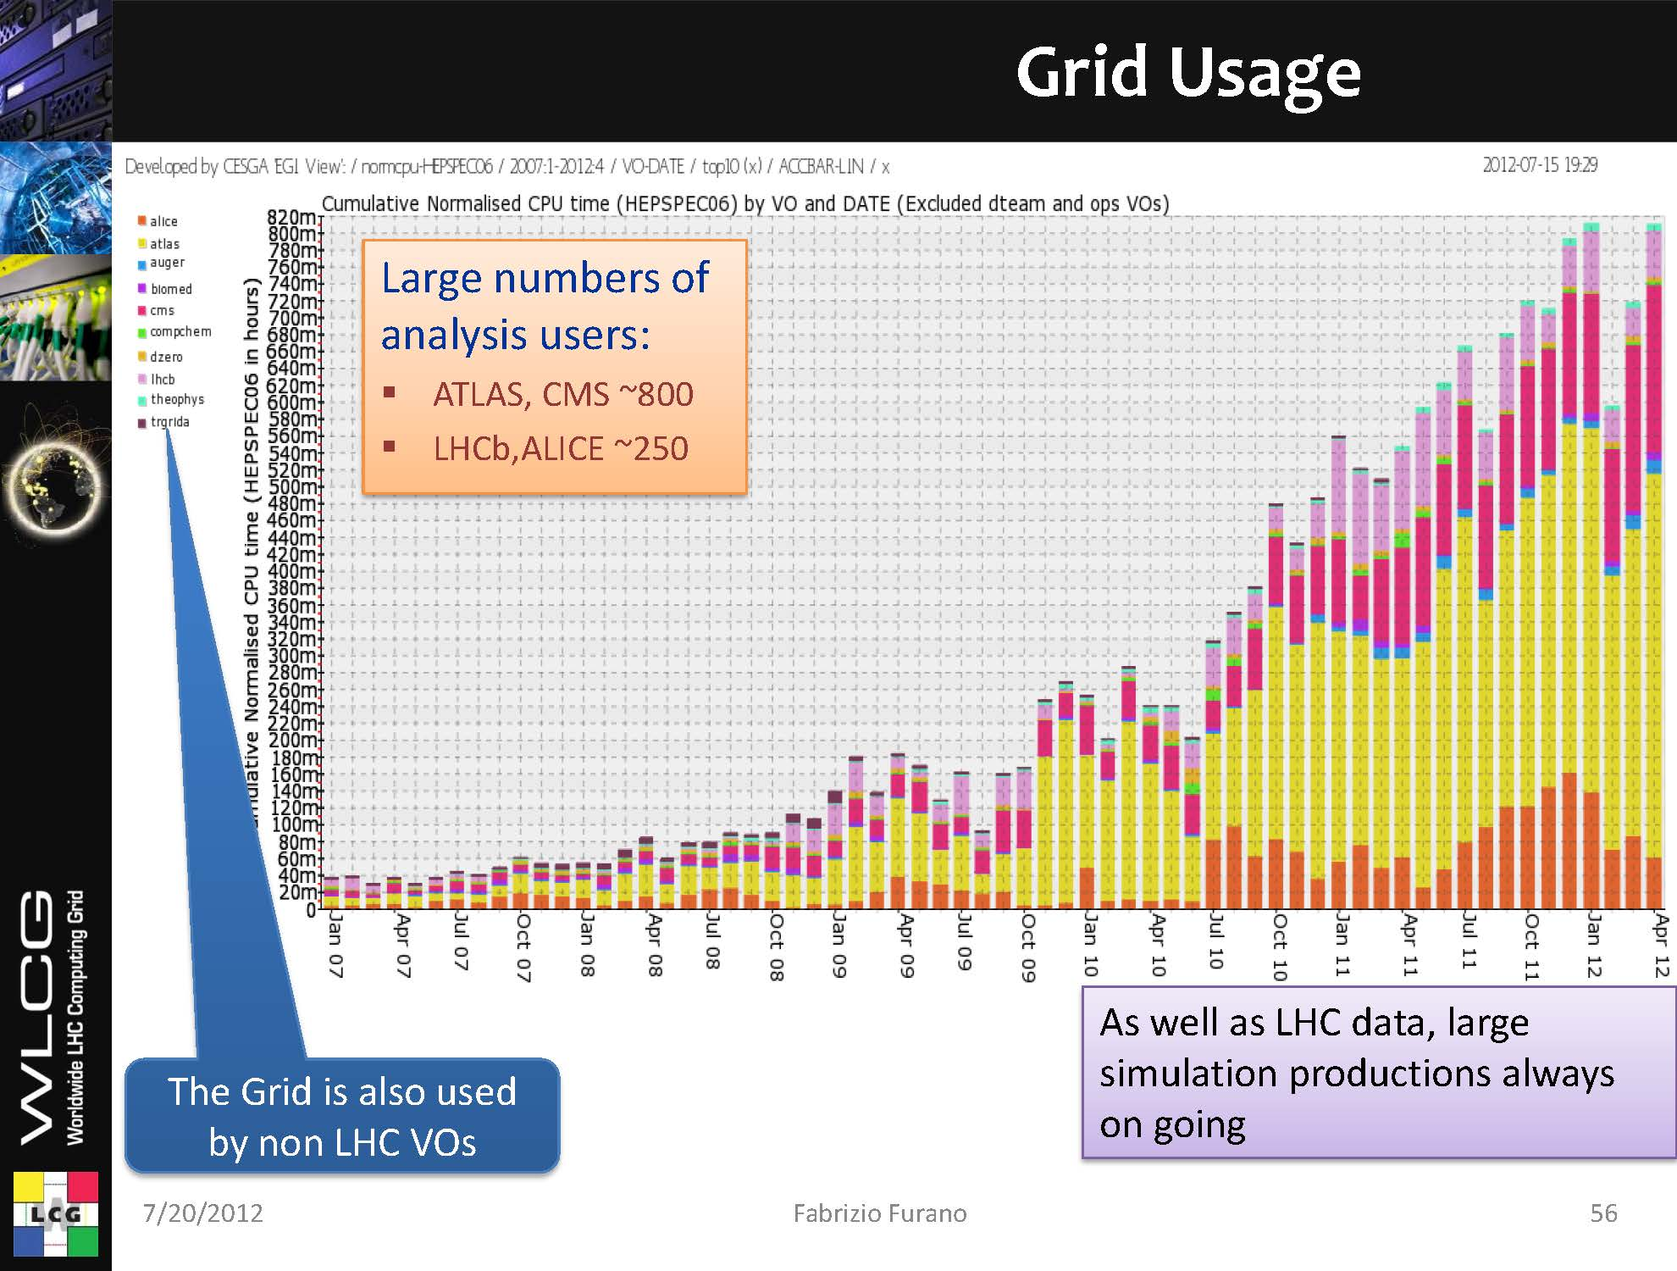
F. Furano, CERN-IT
820 million hours/month
~ 100,000 dual core Intel Xeon
3.20GHz, 800MHz FSB

Slide 19
- II -
Monte-Carlo
Event simulation

Slide 20
First link in the simulation chain: Event generation
Hadronization
b
c
s⁻
Heavy Quarks
W⁺
u⁻
d
W⁻
Parton shower
jets
χ₁⁰
t⁻
t
χ₁⁰
χ₁^{-~}
u
t^{-~}
Hard sub-process
g~
u~
u
g
Proton
Proton
Multiple interaction/underlying event

Slide 21
From Physics models to Simulation
Physics process probability (Matrix Element)
Event generators
Data Analysis by the
Matrix Element Method

Slide 22
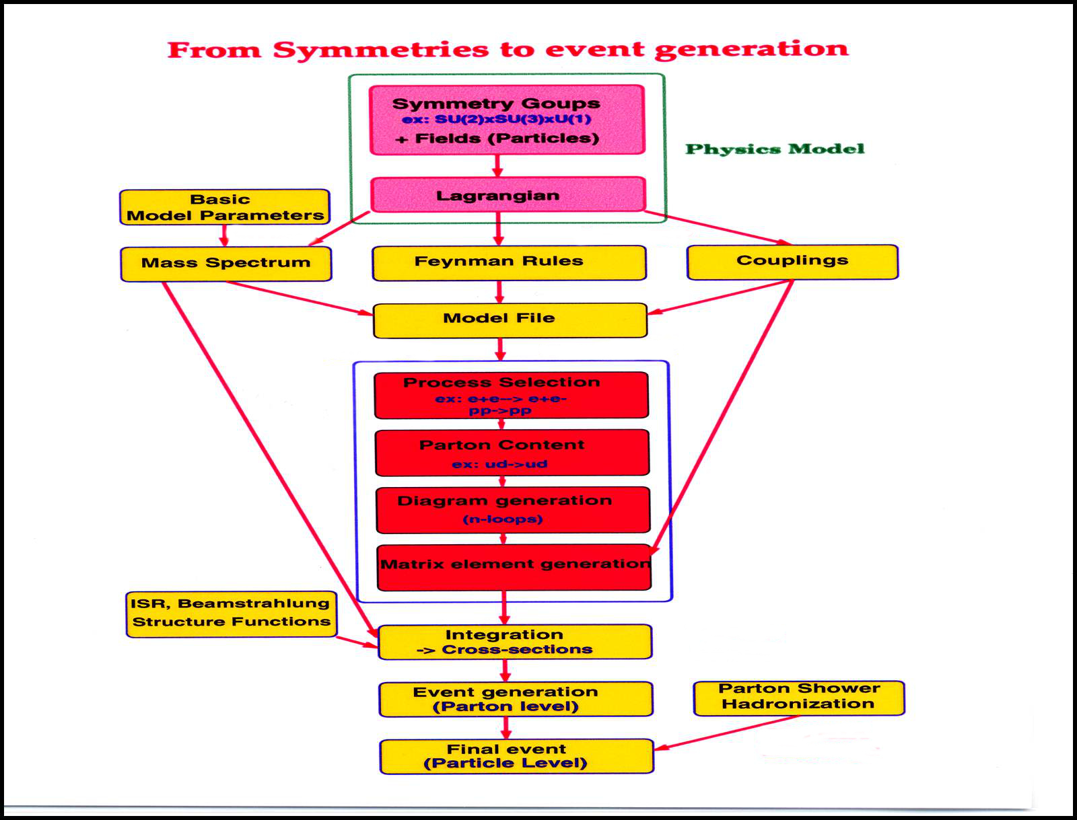
Symbolic computation
- Reduce, Form, Maple, Mathematica, ..
- LanHEP, FeynRules
Automation
Grace, CompHEP, CalcHEP, FeynCalc,
Amegic++, Sherpa, Madgraph, Whizard,
Alpgen, Powheg, …,
NLO: MC@NLO, MCFM, Blackhat+Sherpa
Golem, Gosam, …
Ab Initio Automatic
matrix element generation
Parton Distribution Functions
LHApdf: CTEQ, MRST, …
ISR, Beamstrahlung
CIRCE,…
Numerical Multi-dimensional
Integration
Vegas, Bases, Dice,Vamp, Parint,
A generator of
event generators
Pythia, Herwig

Slide 23
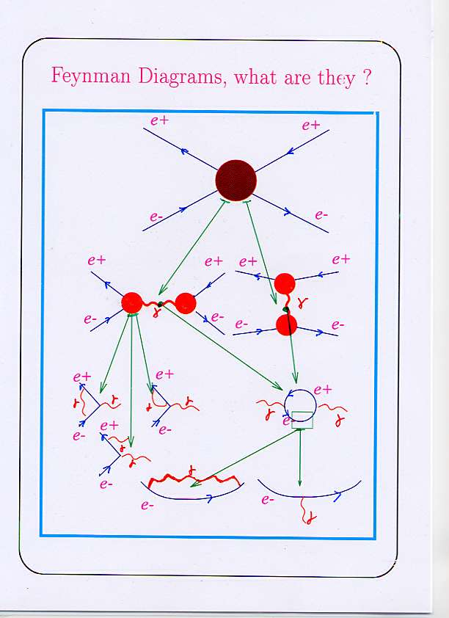
Feynman diagrams in
Pertubative theory
Loops and Legs
QED example
Leading Order
LO,1st order or tree level
Next Leading Order
NLO
Next Next Leading Order
NNLO

Slide 24
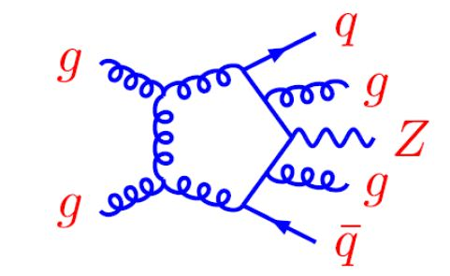
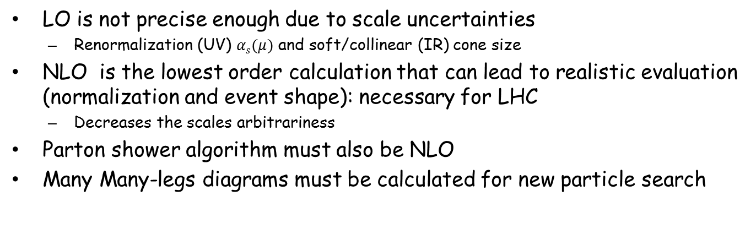
Perturbative QCD requires higher orders calculations
LO is not precise enough due to scale uncertainties
  Renormalization (UV) $αs(μ)$ and soft/collinear (IR) cone size
NLO is the lowest order calculation that can lead to realistic evaluation (normalization and event shape): necessary for LHC
  Decreases the scales arbitrariness
Parton shower algorithm must also be NLO
Many Many-legs diagrams must be calculated for new particle search
e.g. 2→ 5 at NLO

Slide 25
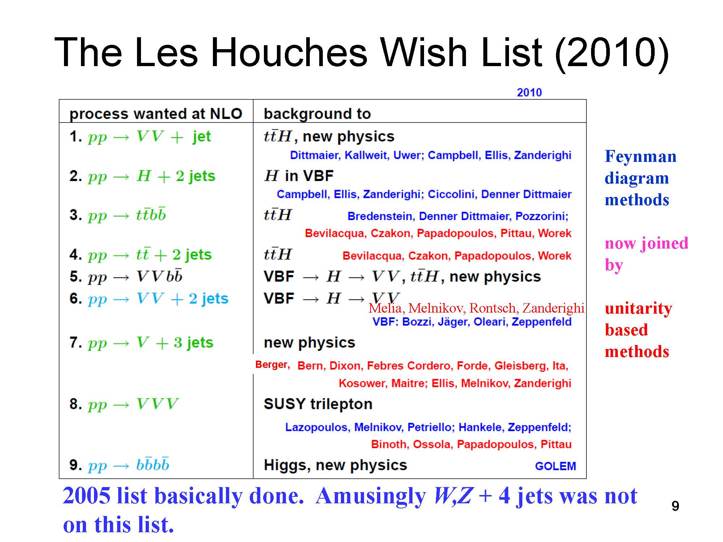
Zvi BERN, UCLA, 2011

Slide 26
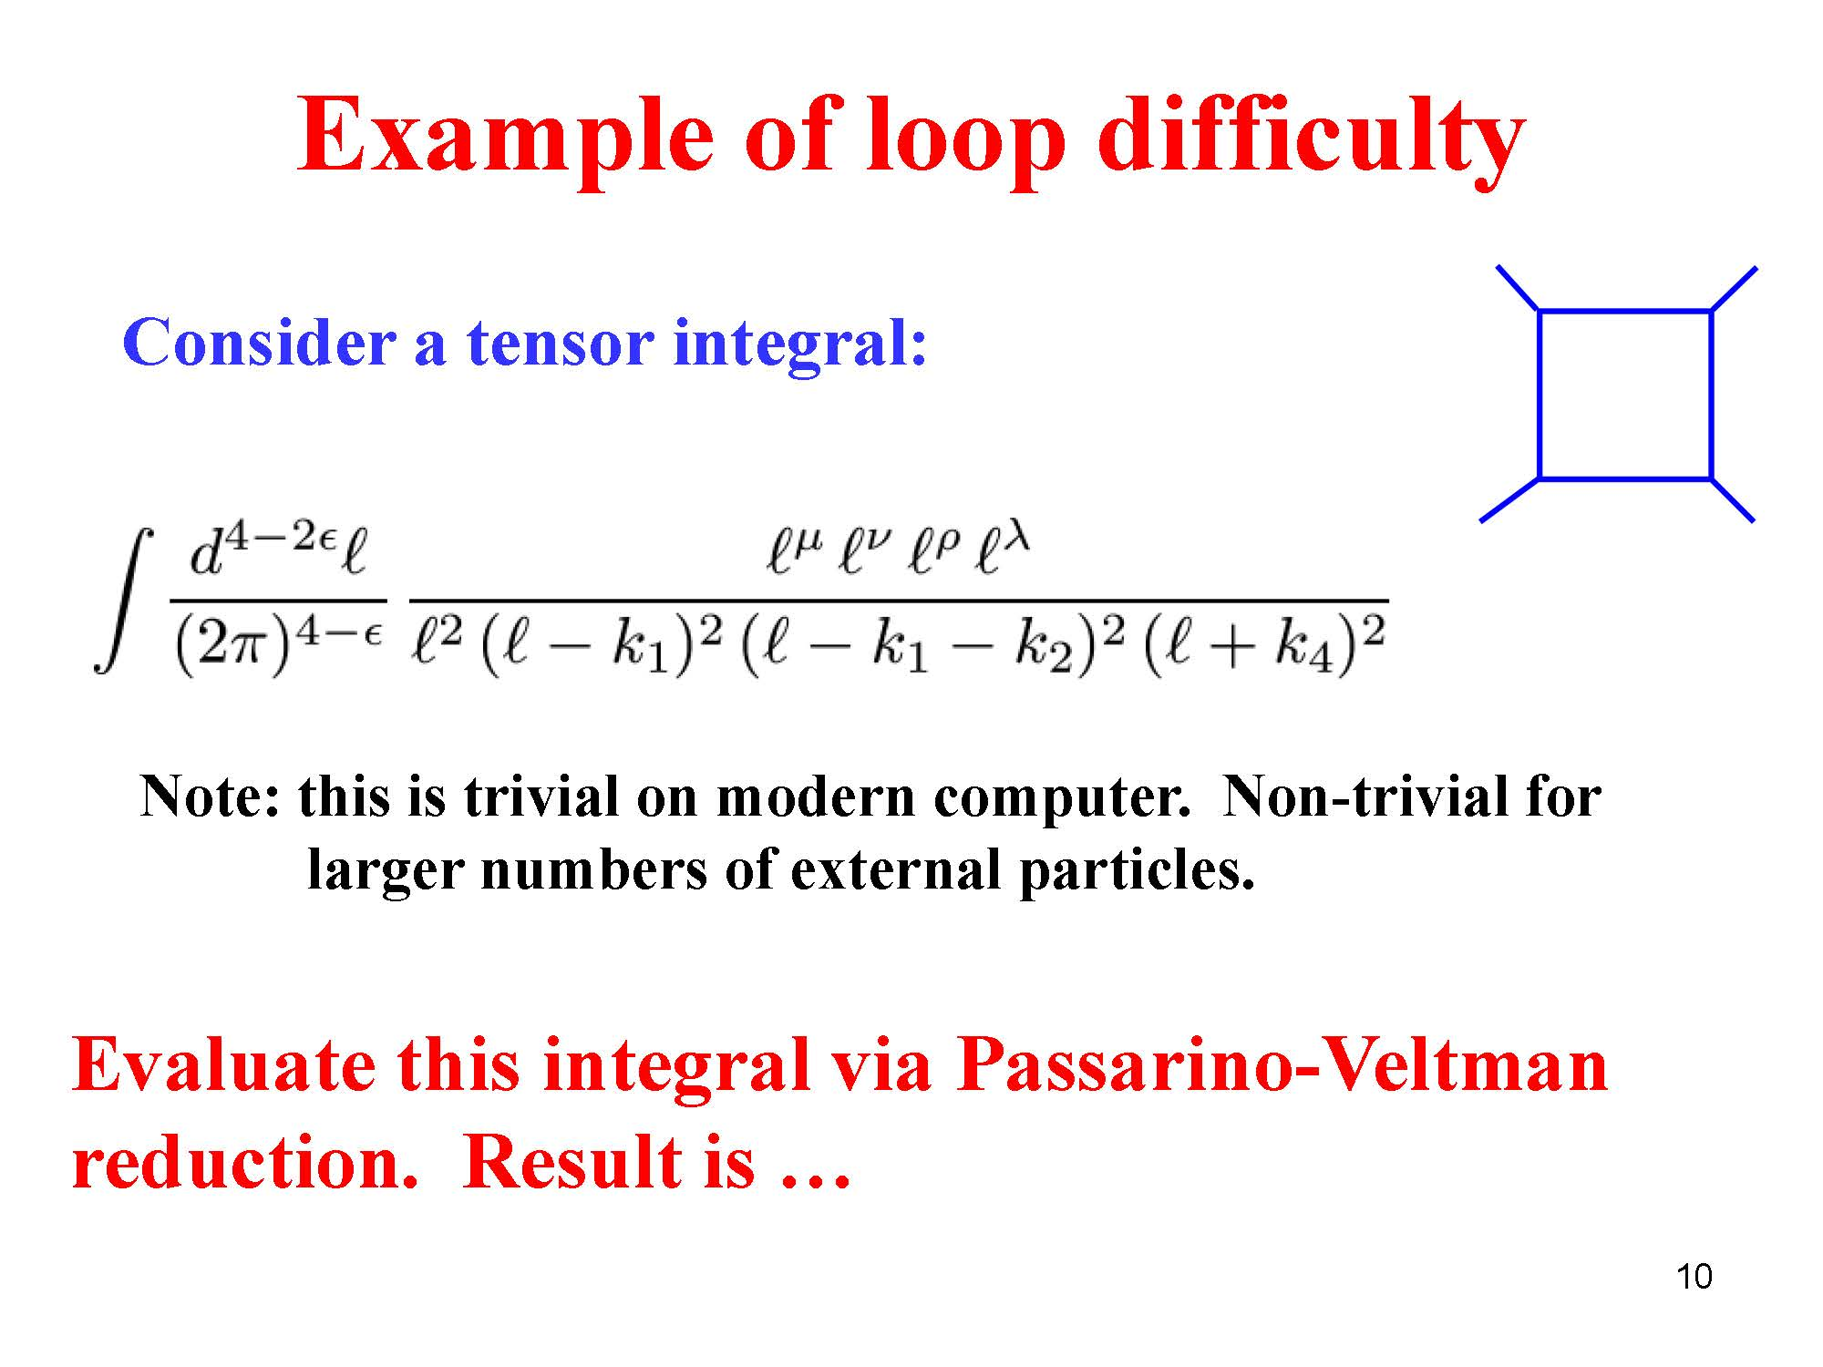
Zvi BERN, UCLA, 2011

Slide 27
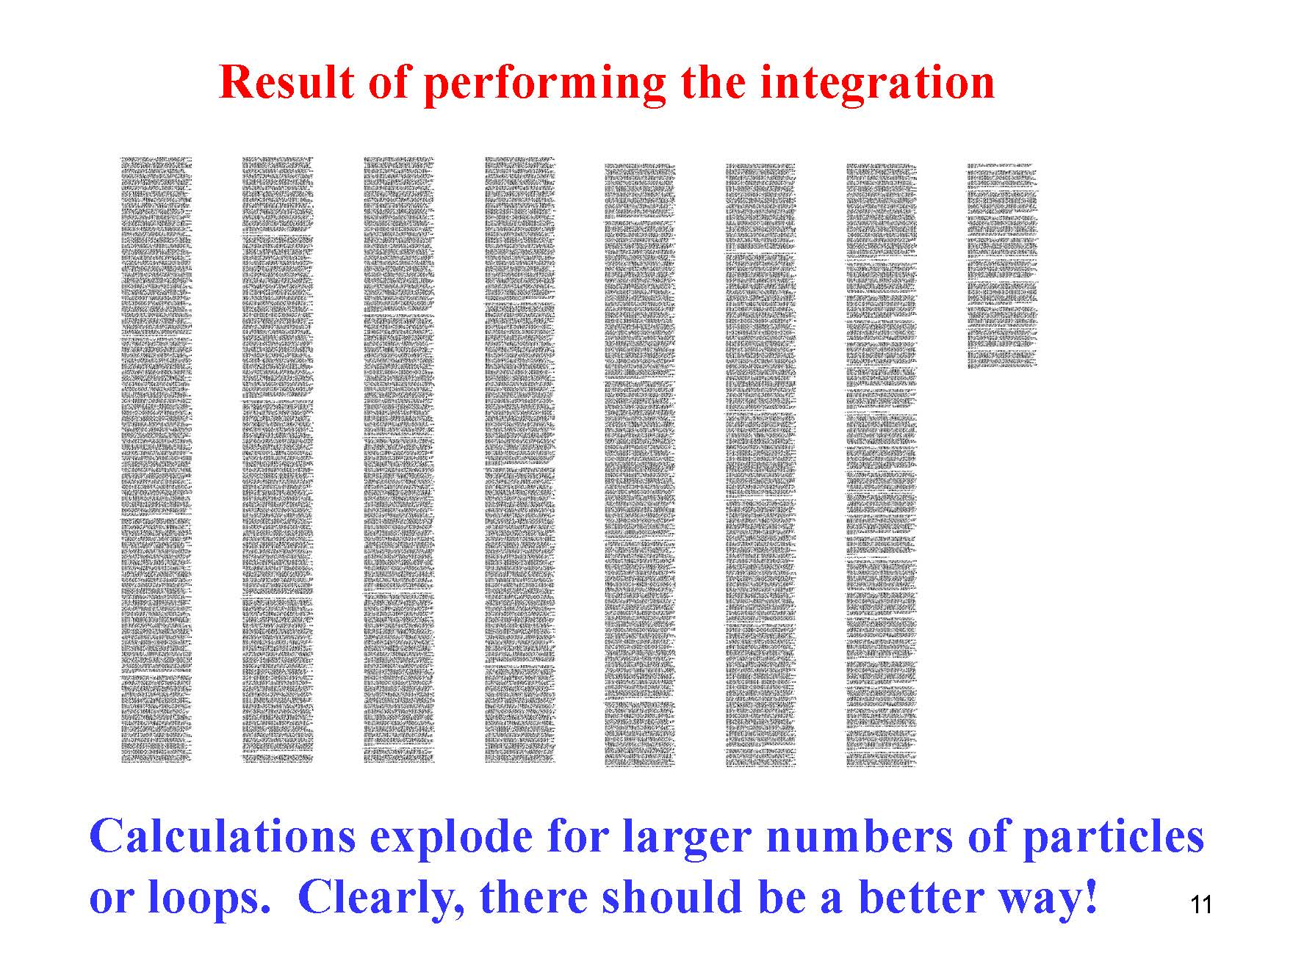
Zvi BERN, UCLA, 2011

Slide 28
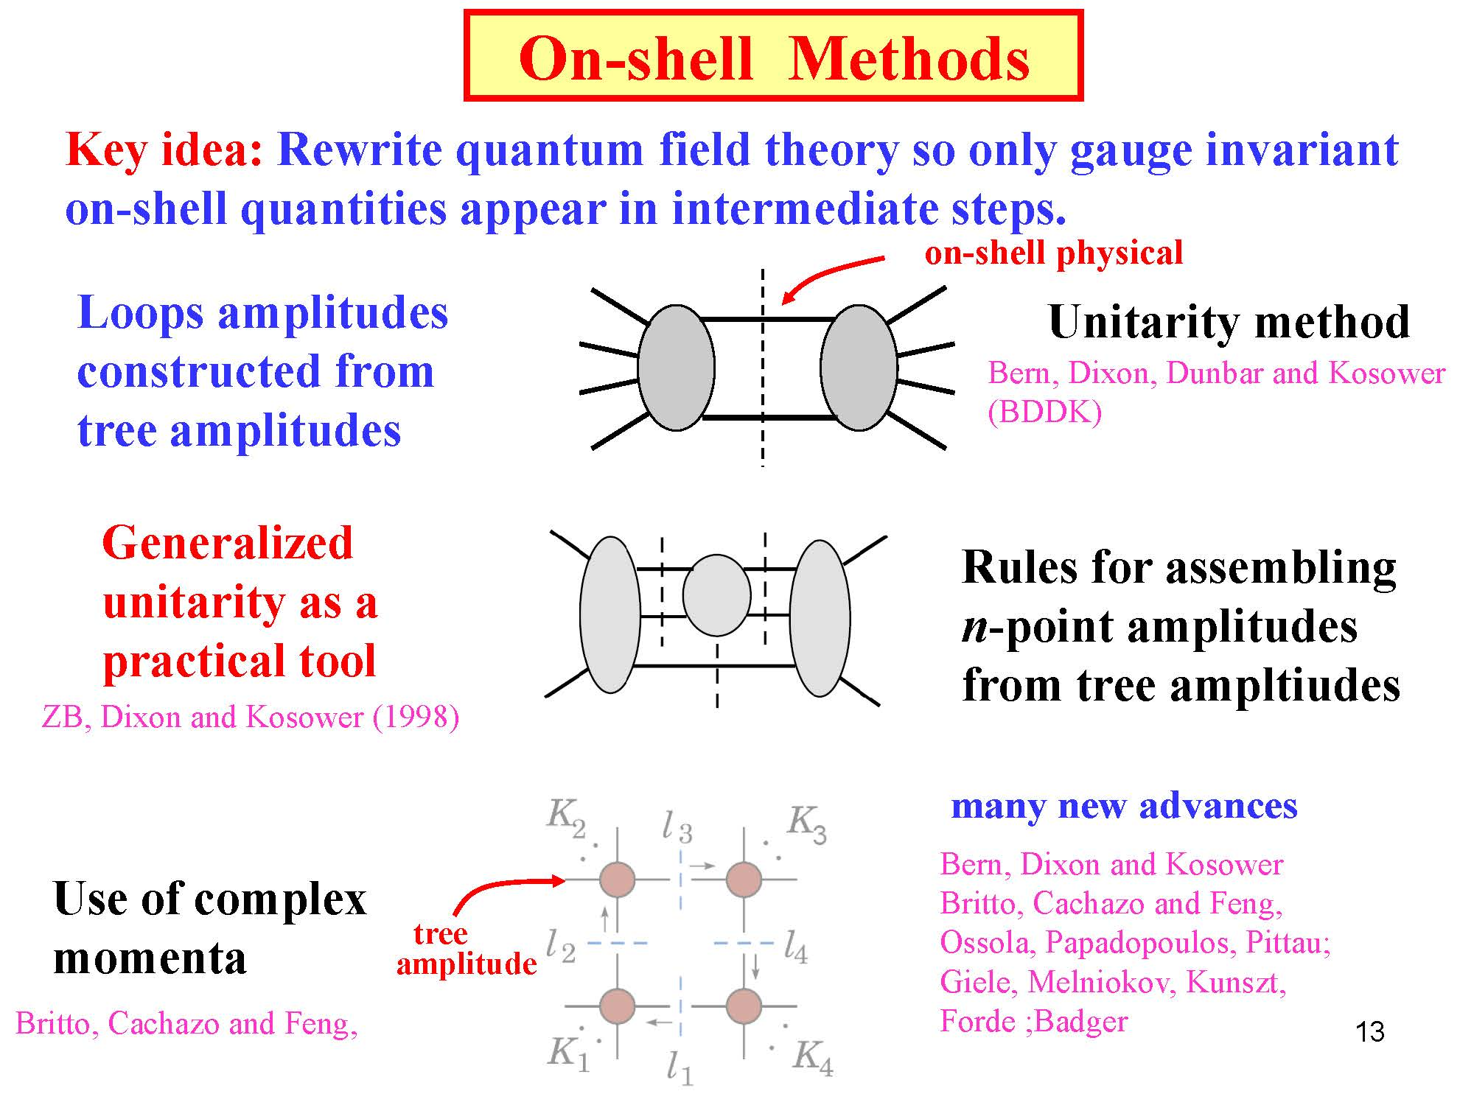
Zvi BERN, UCLA, 2011

Slide 29
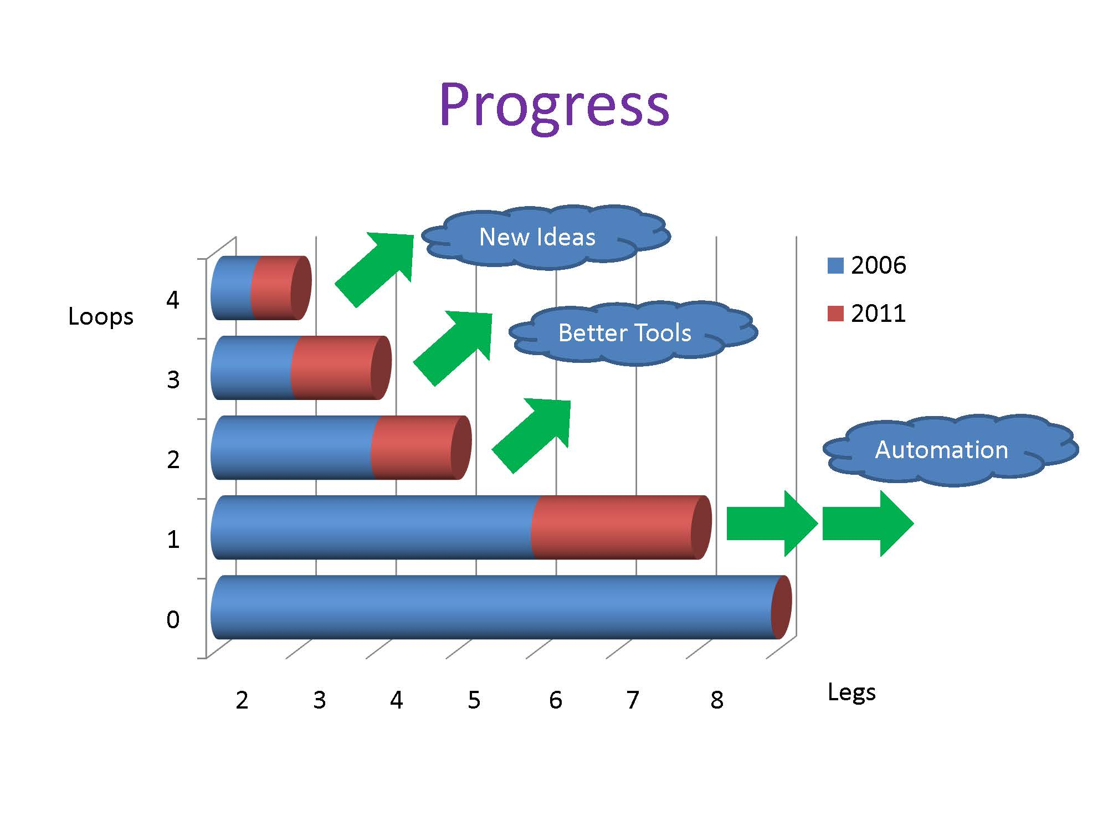
NLO Revolution
…
NNLO
NLO
LO
N. Glover Durham Univ. UK, ACAT’2011

Slide 30
Multi-dimensional integration
Vegas, Bases, Dice, Vamp, Parint
Large number of dimensions
  @LO: N_{d =} 3N_{legs} –5
  More at higher orders
Singularities and kinematics
  Intensive and High Precision floating-point (quad or more)
  Specific manual variable transforms (sometime necessary)
Monte-Carlo technique: CPU time consuming
  Adaptive grid segmentation (
    Importance sampling (region of largest integrant)
    Stratified sampling (region of the largest variance)
  Multi-channel sampling (sum of well behaved functions) (Vamp)
  Parallel quasi-Monte Carlo techniques and extrapolation (Parint)
  Parallelism (many-core, GPU, …)
Poster 7: E. De Doncker (Western Michigan Univ.,USA),
Shared memory iterated numerical integration for Feynman loop integrals
See:
Poster 166: F. Yuasa (KEK, Japan):
Acceleration of Feynman loop integrals in HEP on many core GPUs.

Slide 31
- III -
Event Analysis
Matrix Element Likelihood Method
New Use of Matrix Elements

Slide 32
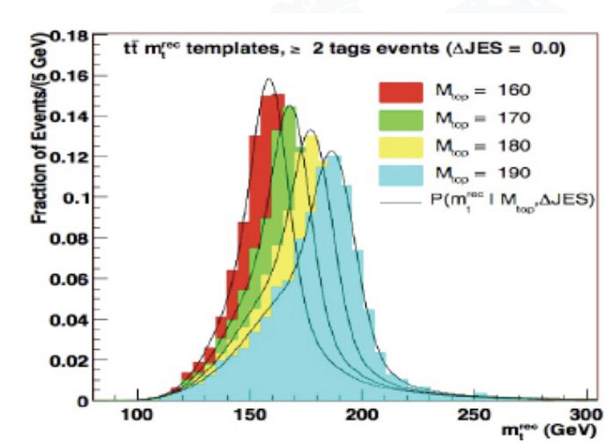
Conventional Methods e.g. Higgs mass in γγ
Template
Select events based on cuts defined by MC studies
Build histograms on estimator (i.e. γγ mass)
Compare histograms with MC simulation for different values of the Higgs mass
Likelihood on histogram fit
Easy to implement, but
Full event info not used

Slide 33
Matrix Element Methods e.g. Higgs mass in γγ
Select events based on cuts defined by MC studies
Use matrix element to weight events for each similar process (signal and backgrounds)
Build and maximize likelihood of mass hypothesis
More involved and CPU intensive, but
Full event kinematics information is used
Improvement of statistical uncertainty
Separation between theory and experimental inputs
Complementary to template methods (different statistical significance)
K. Kondo 90 (top mass)
D0, CDF,
Madweight,
ATLAS, CMS Mela
For Precision measurement and
search for new phenomena

Slide 34
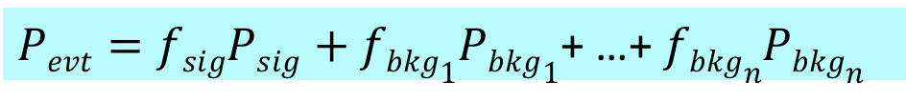
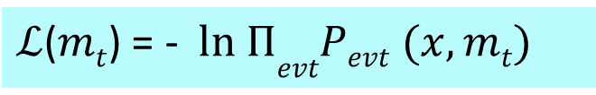
Matrix Element Method in a nutshell
e.g. Top mass evaluation
For each event:
$Psig( x, mt$ )= $\frac{1}{N}\int_{y,q1,q2}{dΦ6 }$|$ℳtt̅$|² W($x$,y) f_{pdf}(q₁) f_{pdf}(q₂) dq₁dq₂
Measured kinematics
Top mass hypothesis
Matrix element for tt̅ production and decay into y partonic state
Transfer Function between x and y state
with detector resolution and hadronization.
For each event, all possible processes (matrix elements):
$Pevt=fsigPsig+fbkg1Pbkg1$+ …+ $fbkgnPbkgn$
For the selected event sample: minimize the negative likelihood
$ℒ$($mt$) = - $ln ΠevtPevt (x,mt)$

Slide 35
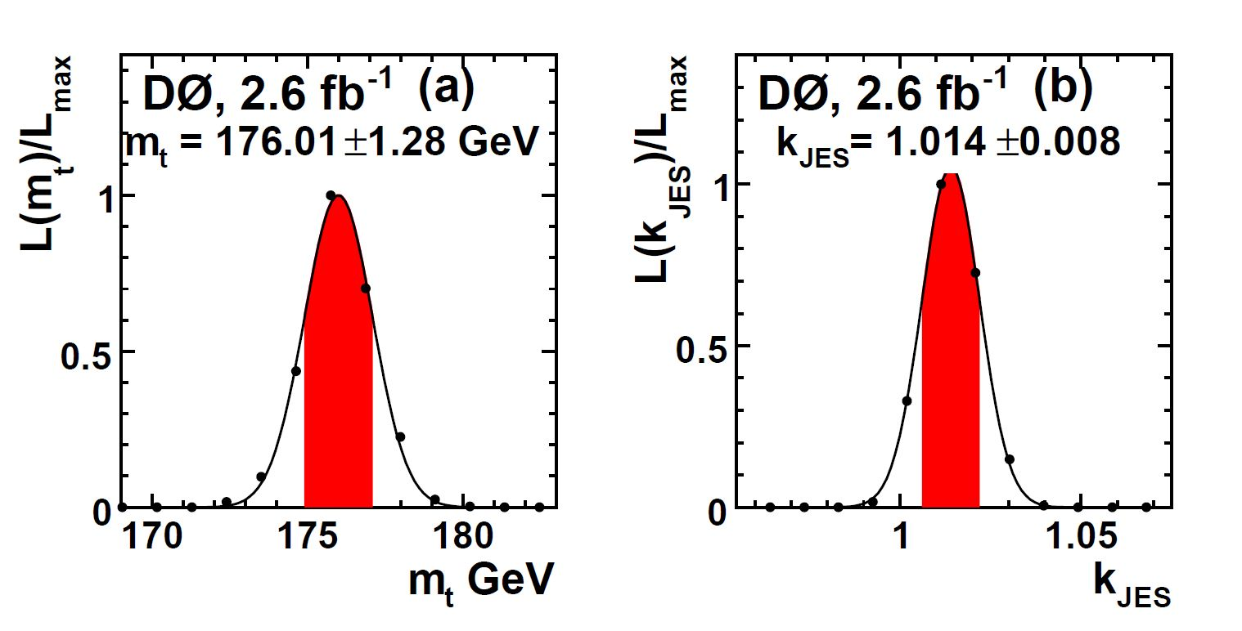
Top mass measurement

Slide 36
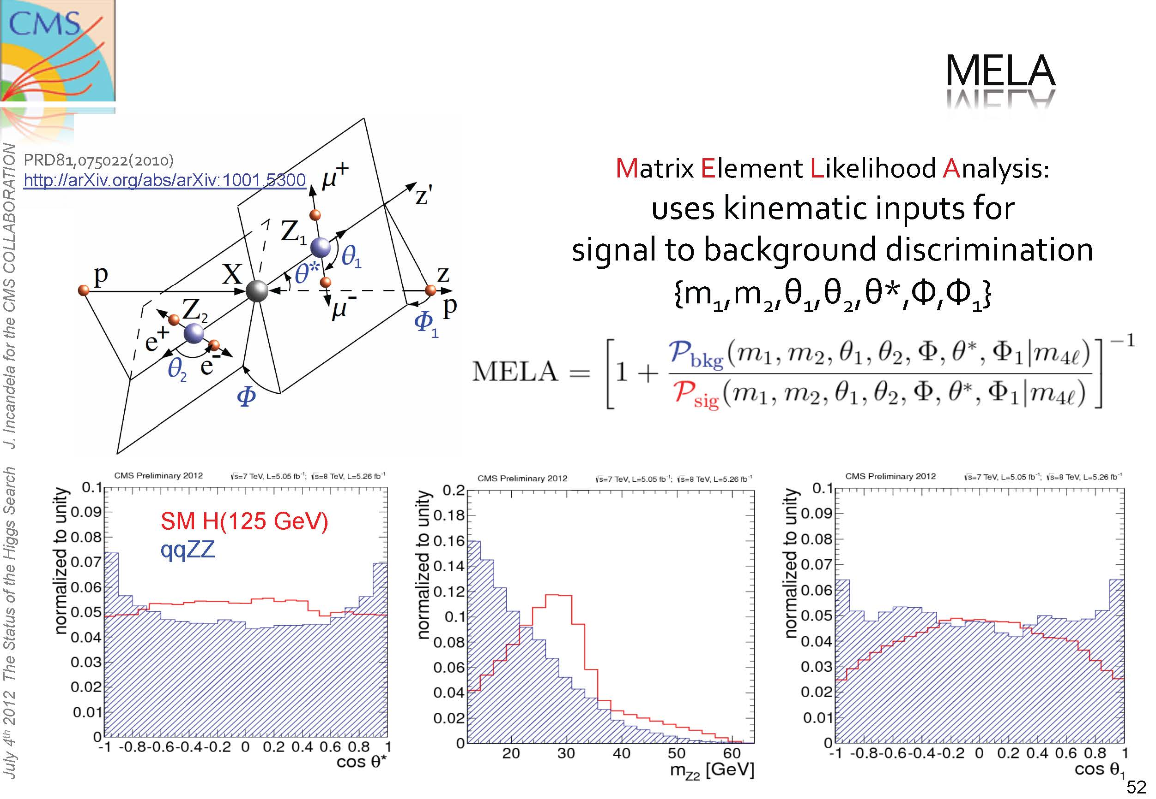
H->ZZ*
MELA[0,1] 0: background
1: signal

Slide 37
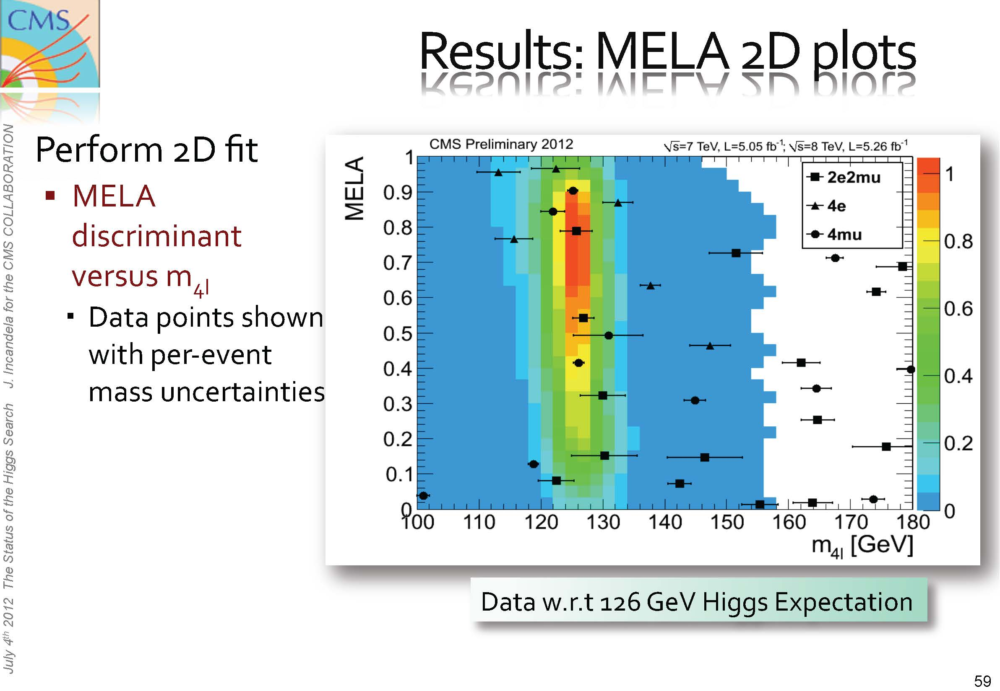

Slide 38
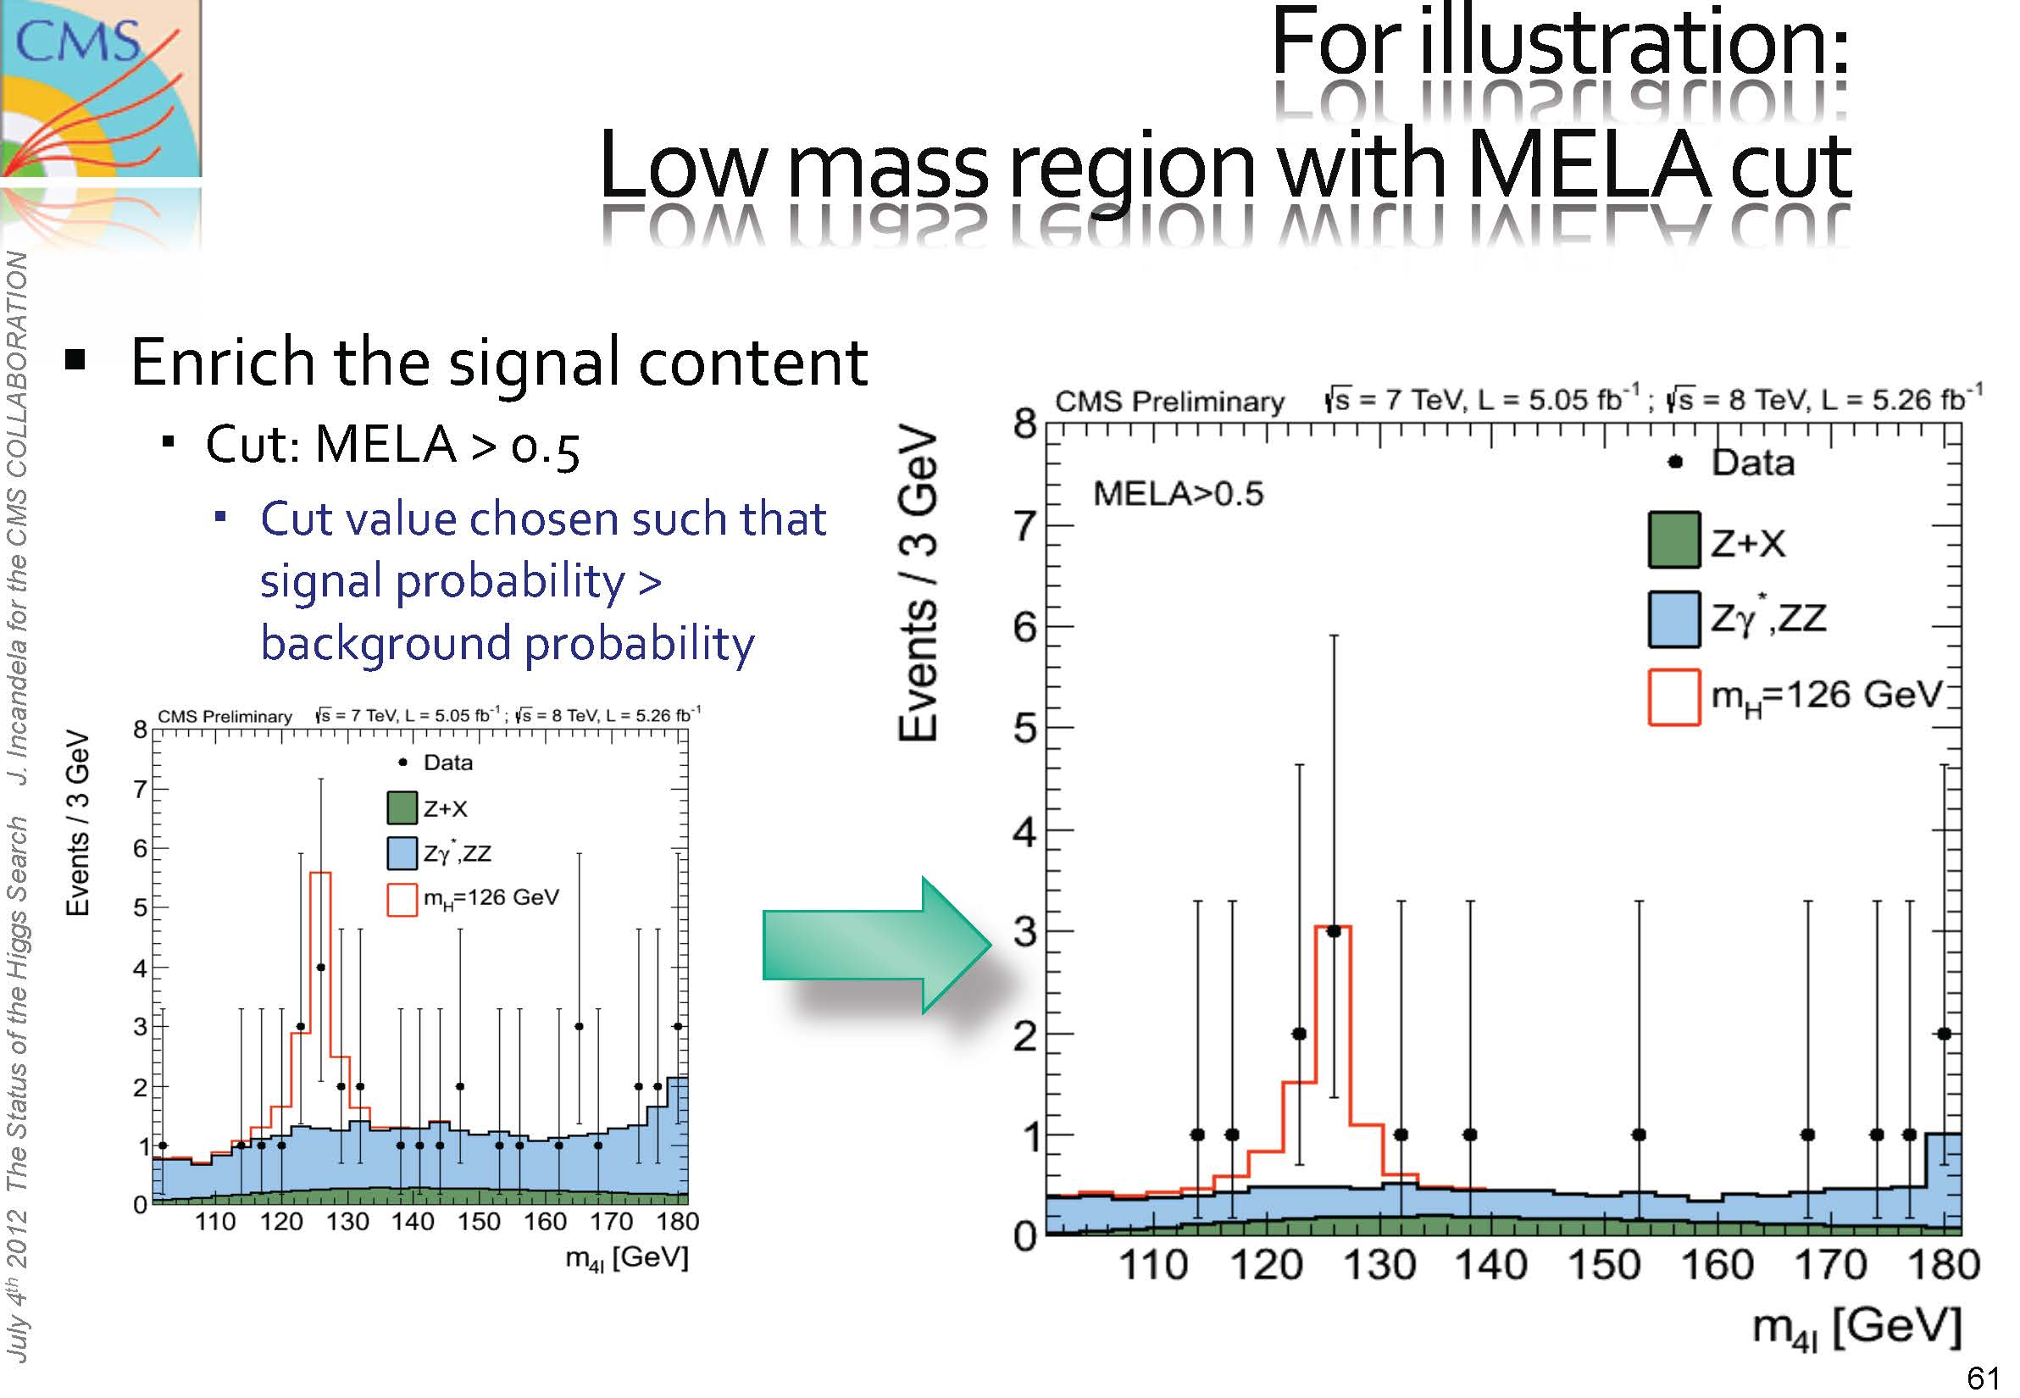

Slide 39
Cross disciplinary Issues
Symbolic manipulation packages (mathematica, maple, reduce,…)
  Form
    Expression size: only limited by disk space and cpu time
    Parallel form
Numerical multi-dimensional integration packages
  Large integrands
  Singularities
Parallel computation (symbolic, automation, integration, ..)
  Efficient use of many-core (long term trend of the industry)
  Portable enough for other architectures (GPU, …)
Floating point high precision
  Quad, Octuple precision, … sometime reduces le nb of iteration
Automation and gluing different packages (perl, python, java, …)
Large computing world-wide infrastructures (Data grid, Clouds,..)
Data Analysis toolkits (root) and statistical methods: NN, multivariate analysis, …
ACAT 2013, 15th Int. Workshop on Advanced Computing and Analysis Techniques for Research Beijing (May 16-21, 2013) http://acat2013.ihep.ac.cn/

Slide 40
Conclusions I
Physics simulations
Monte-Carlo event simulations: mandatory for Experimental Design and Data Analysis in HEP
Automatic calculation of physics processes is now the rule
  NLO calculations are needed for LHC(QCD) studies.
  NLO revolution open widely the field of possible new needed calculations.
  But computing time and memory size become an issue

Slide 41

Conclusions II
Automatic Matrix elements or amplitude calculations
Event generators
  Process automatic calculations
    Many Physics Models, many processes, many diagrams, higher orders
  Matrix element automatic construction:
    tree level done but needs kinematics tuning for efficiency
    1-loop processes in (big) progress
  Many event generators available
Data Analysis for precision and new physics
  Matrix Element Method
    Full use of event information, best error estimate
    complementary to the template method
    but cpu time consuming

